Slide 1
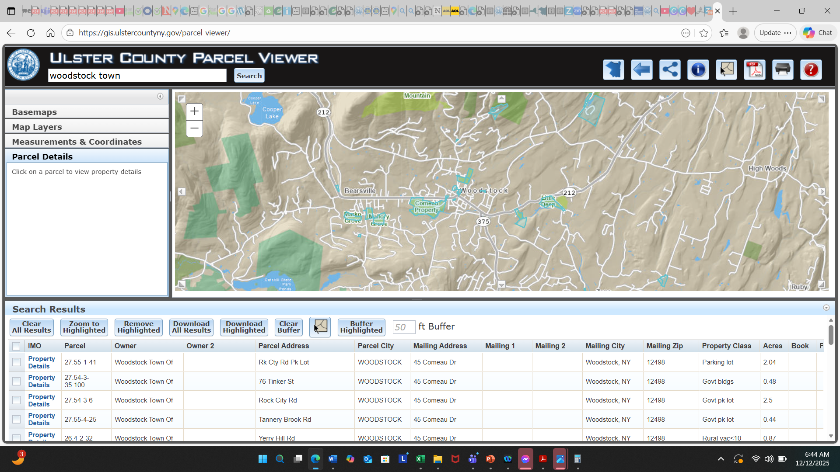
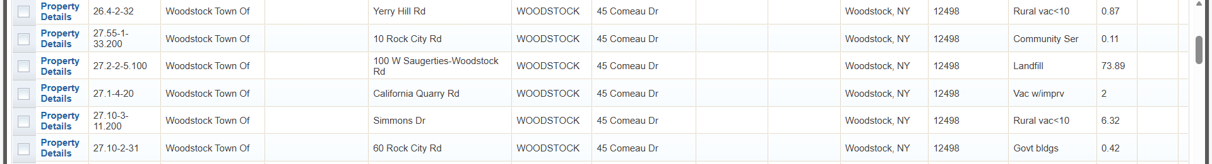
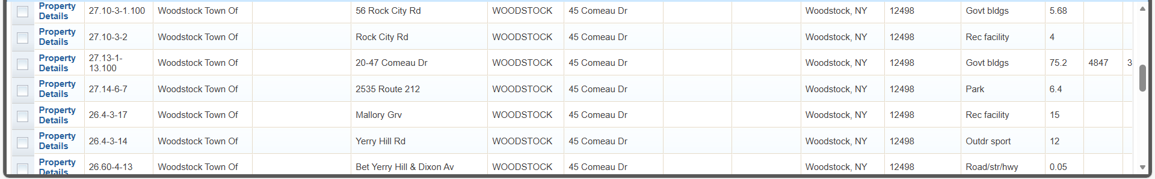
Town of Woodstock Properties as of December 12, 2025, as per the Ulster County Parcel Viewer
https://gis.ulstercountyny.gov/parcel-viewer/
33 properties (17 + 16), used a search criteria of: woodstock town
Page 1 of 2

Slide 2
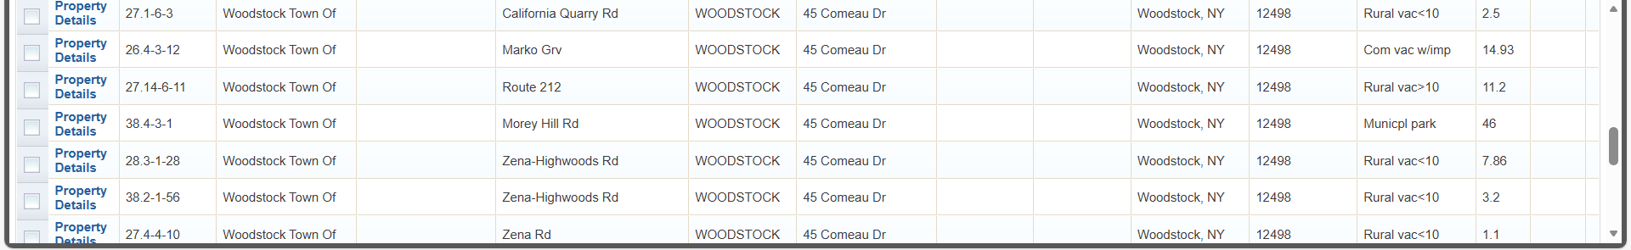

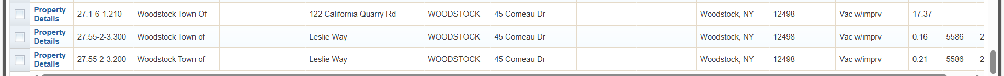
Town of Woodstock Properties as of December 12, 2025, as per the Ulster County Parcel Viewer
https://gis.ulstercountyny.gov/parcel-viewer/
33 properties (17 + 16), used a search criteria of: woodstock town
Page 2 of 2

